Slide 1
Assessing the Location of Human West Nile Cases in The United States
By Kaylee McKay

Slide 2
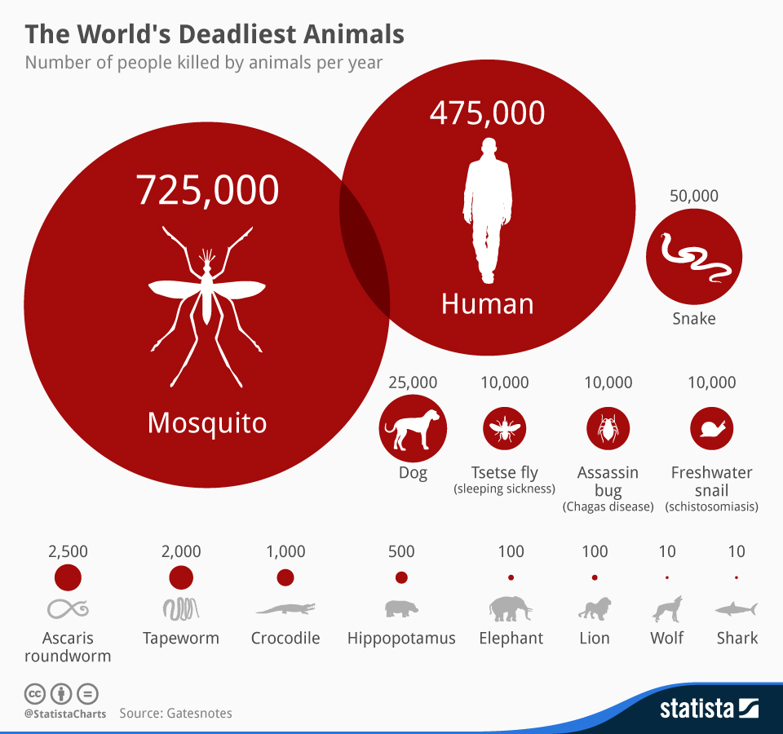

Slide 3
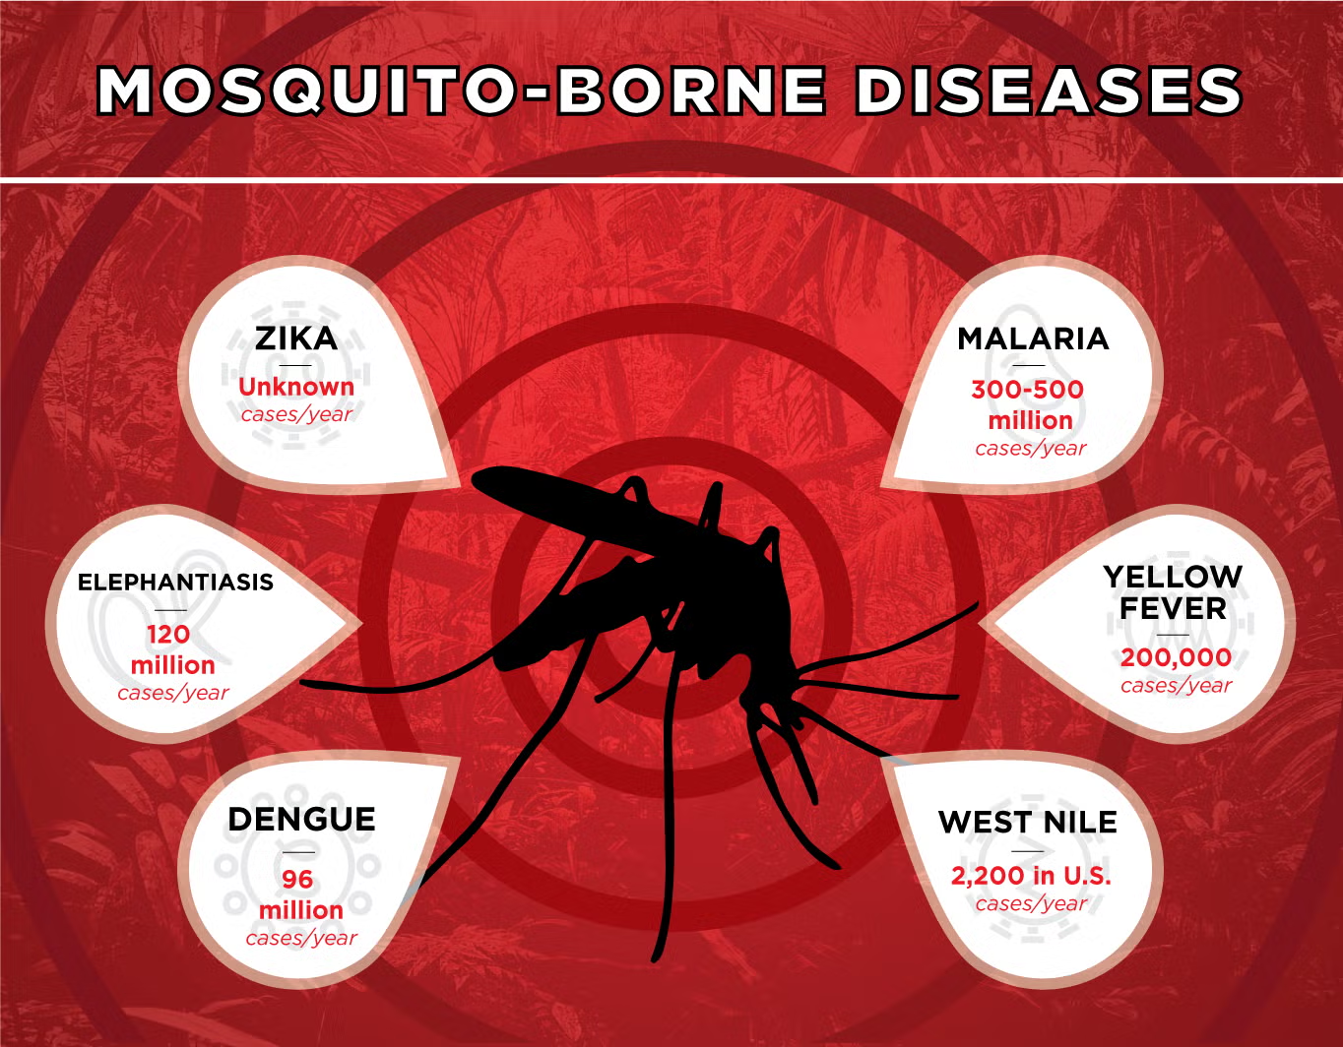

Slide 4
Is there a way to maximize West Nile Virus prevention efforts?
Vector control can be expensive
Can be unnecessary in some places
Regulations may vary

Slide 5
Where is West Nile Virus most prevalent in The United States?

Slide 6
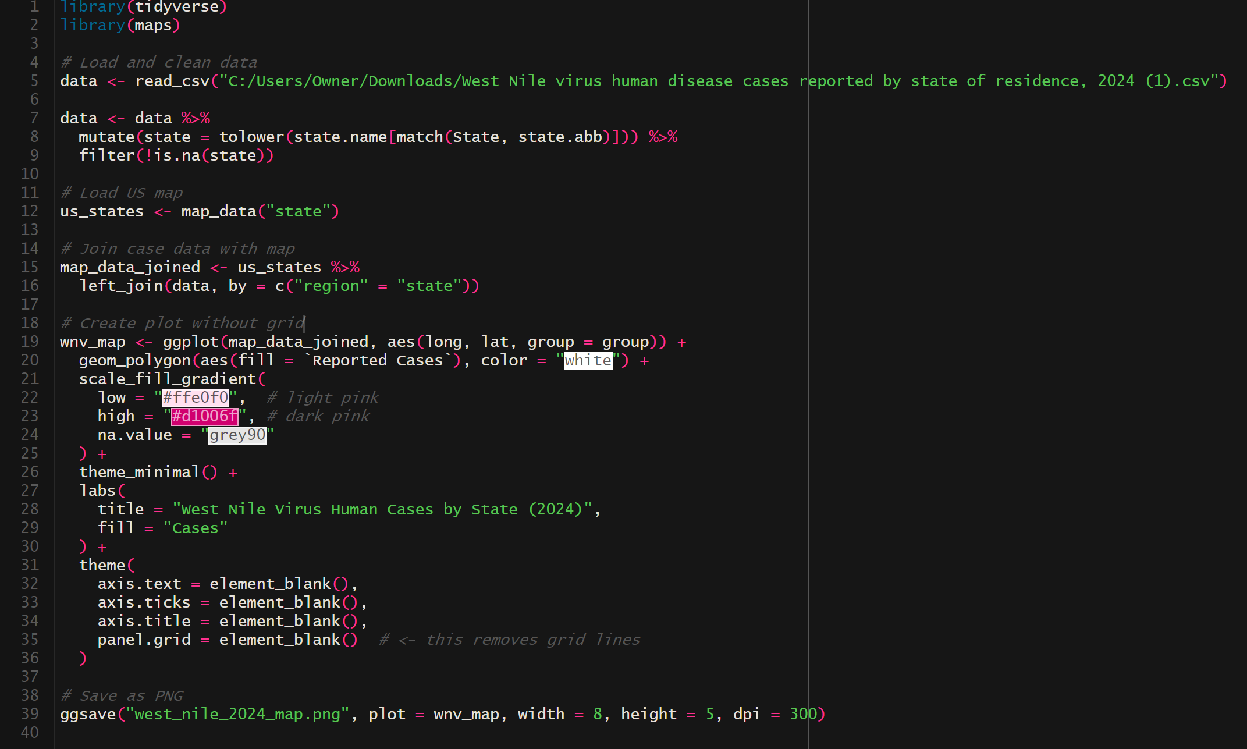
Notes:
Initially loading in the packages needed
Maps provides a collection of functions and geographic data for creating basic maps using base R graphics and compatible with ggplot and other packages
Loading in data provided from the CDC on the location of Human West Nile Virus Cases in the untied states
Cleaned
Translates US state abbreviations in the State column into lowercase full state names.
Filters out any rows where the abbreviation could not be matched.

Slide 9
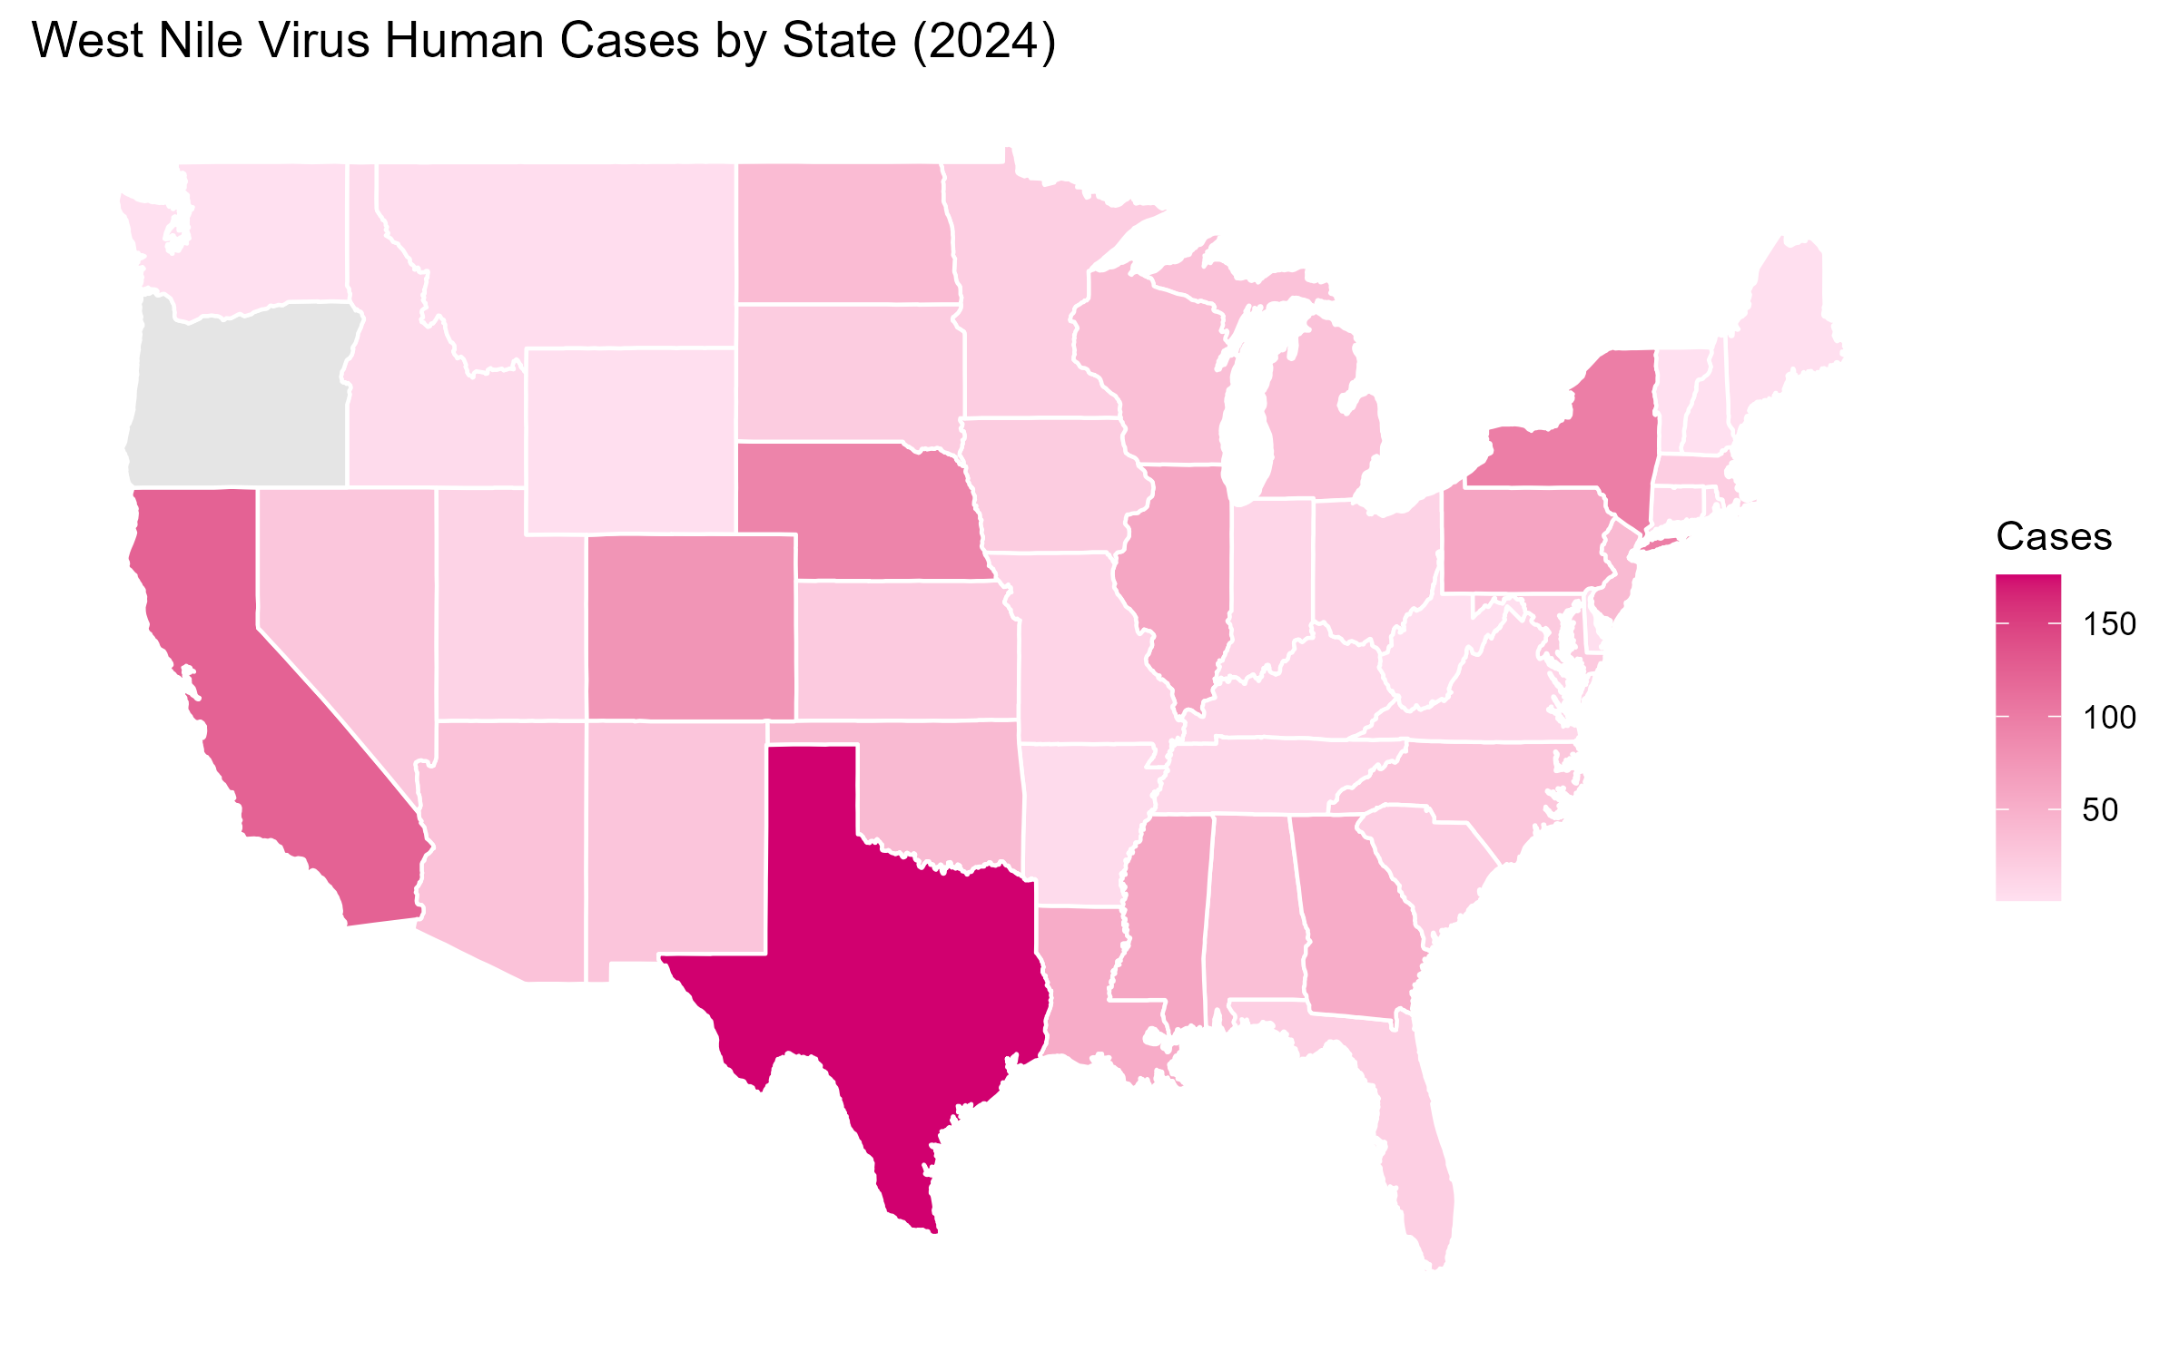

Slide 10
How can this code be useful?
Targeted vector control
Can input data for other years
Tracking progression

Slide 11
References
Centers for Disease Control and Prevention. (n.d.). Current year data (2024). Centers for Disease Control and Prevention. https://www.cdc.gov/west-nile-virus/data-maps/current-year-data.html
Bailey, P. (2019, May 2). Zika virus and other ailments take flight (infographic). UC Davis. https://www.ucdavis.edu/news/zika-virus-and-other-ailments-take-flight-0
McCarthy, N., & Richter, F. (2014, May 5). Infographic: The world’s deadliest animals. Statista Daily Data. https://www.statista.com/chart/2203/the-worlds-deadliest-animals/
Environmental Protection Agency. (n.d.). EPA. https://www.epa.gov/climate-indicators/climate-change-indicators-west-nile-virus

Slide 12
Questions?

